Slide 1
Unit 9
MANAGEMENT INFORMATION SYSTEMS 8/E
Raymond McLeod, Jr. and George Schell
Executive Information Systems;
Enterprise Information Systems;
&
Information Resources Information Systems
1-<number>
Copyright 2001 Prentice-Hall, Inc.
Notes:
1

Slide 2
Chapter 16
MANAGEMENT INFORMATION SYSTEMS 8/E
Raymond McLeod, Jr. and George Schell
Executive Information Systems
16-<number>
Copyright 2001 Prentice-Hall, Inc.
Notes:
1

Slide 3
The Executive Position
Unique demands of the executive position
Executives require unique information processing
  An executive is not just a lower-level manager on a higher level!
16-<number>
Notes:
2

Slide 4
A Firm Without
An EIS
Environmental information and data
Top-level
managers
Human
resource
information
system
Marketing
information
system
Manufacturing
information
system
Financial
information
system
Environmental information and data
16-<number>

Slide 5
A Firm With
An EIS
Environmental Information and data
Executive
information
system
Human
resource
information
system
Marketing
information
system
Manufacturing
information
system
Financial
information
system
Environmental Information and data
16-<number>
Notes:
4

Slide 6
What Do Executives Do?
Term executive is loosely applied
  No clear dividing line between executives and other managers
Executive manager on the upper level of the organizational hierarchy who exerts a strong influence on the firm
Long term planning horizon
16-<number>
Notes:
5

Slide 7
Fayol's Management Functions
Plan
Organize
Staff
Direct
Control
16-<number>
Notes:
6

Slide 8
Mintzberg's Managerial Roles
Different levels of management perform same roles but relative time spent on each differs
High-level management focus
  Long-range, entrepreneurial improvements
  Responding to unanticipated situations
16-<number>
Notes:
7

Slide 9
Kotter's Agenda and Networks
John P. Kotter, Harvard professor
Executives follow a three step strategy
  Agenda -- objectives the firm is to achieve
  Networks -- cooperative relationships
    Hundreds or thousands
    Inside and outside the firm
  Environment -- norms and values so the network members can achieve agendas
16-<number>
Notes:
9

Slide 10
How Do Executives Think?
Daniel J. Isenberg, Harvard professor
Studied more than one dozen executives over a 2-year period
What they think about
  1. How to get things done
  2. A few overriding issues
16-<number>
Notes:
10

Slide 11
How Do Executives Think? (cont.)
More concerned with process than solution
Thought processes do not always follow the step-by-step patterns of the systems approach
Intuition is used at each step
16-<number>
Notes:
11

Slide 12
Unique Information Needs
Mintzberg was first to conduct a formal study of executive information needs
Studied 5 executives in early 1970s
Five basic activities
  desk work
  telephone calls
  unscheduled meetings
  scheduled meetings
  tours
16-<number>
Notes:
12

Slide 13
How Minzberg’s
CEOs Spent Time
Telephone
Calls
6%
Tours
3%
Scheduled
Desk Work
Meetings
22%
59%
Unscheduled
Meetings
10%
Legend:
Interpersonal
Communication
16-<number>
Notes:
8

Slide 14
Unique Information Needs
Jones & McLeod Study
Studied 5 executives in early 1980s
Questions
  1) How much information reaches the executive ?
  2) What was the information value ?
  3) What are the information sources ?
  4) What media are used to communicate the information ?
  5) What use is made of the information ?
16-<number>
Notes:
13

Slide 15
The Volume of Information Reaching the Executives
HIGH
HIGH
60
50
HIGH
HIGH
AVG
40
AVG
Number of
Transactions
LOW
AVG
30
LOW
AVG
LOW
HIGH
20
LOW
AVG
10
LOW
0
Retail Chain
Bank
CEO
Insurance
Vice
President
of Tax
Vice
CEO
President
President of
Finance
16-<number>
Notes:
14

Slide 16
Jones & McLeod Study (cont.)
How much information reaches the executive
  A transaction - a communication involving any medium
  Daily volume
    Varies from executive to executive
    Varies from day to day
16-<number>
Notes:
15

Slide 17
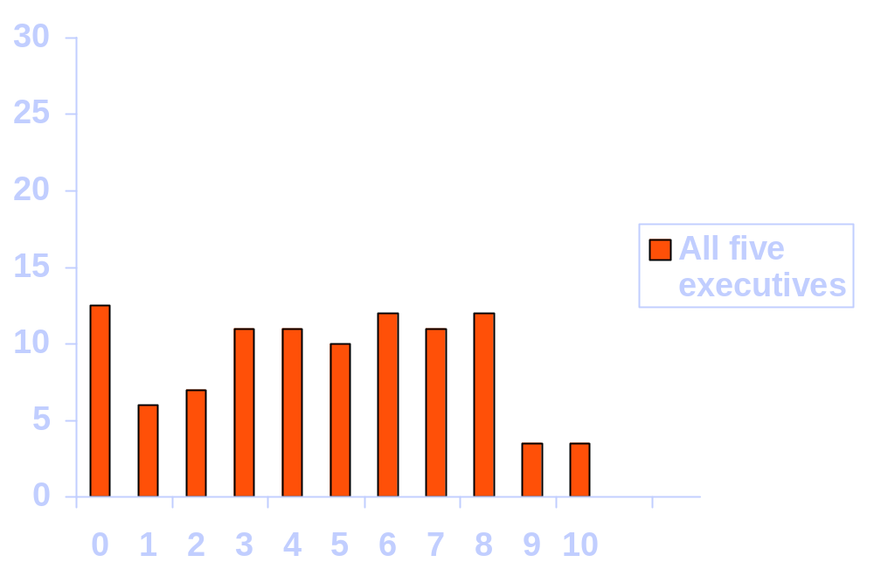
The Value of Information Reaching Executives
Bank CEO
Vice President
of tax
Percentage of transactions
Value
16-<number>
Notes:
17

Slide 18
Sources of Information
Some executives went down 7 levels to gather information
Sources were internal and external
External sources provided the most volume but also the lowest average value
16-<number>
Notes:
18

Slide 19
The Sources of Information Reaching the Executives
Upper levels
.05
Committees
5.2
Environment
.02
7.5
.43
The executive
Internal support units
and individuals
3.8
1 level down
.13
4.6
.20
5.2
2 levels down
.10
5.3
Legend:
3 levels down
.06
Percentage of total
trans-
actions
4.3
4 levels down
Average
transaction
value
16-<number>
.02
4.4
Notes:
19

Slide 20
Media Used for Communication
Written media accounts for 61% of the transactions
  Computer reports
  Letters and memos
  Periodicals
Oral media is preferred by executives
  Tours
  Business meals
  Telephone calls
16-<number>
Notes:
20

Slide 21
The Executive Does not Control:
Letters
Memos
Telephone calls
Unscheduled meetings
16-<number>
Notes:
21

Slide 22
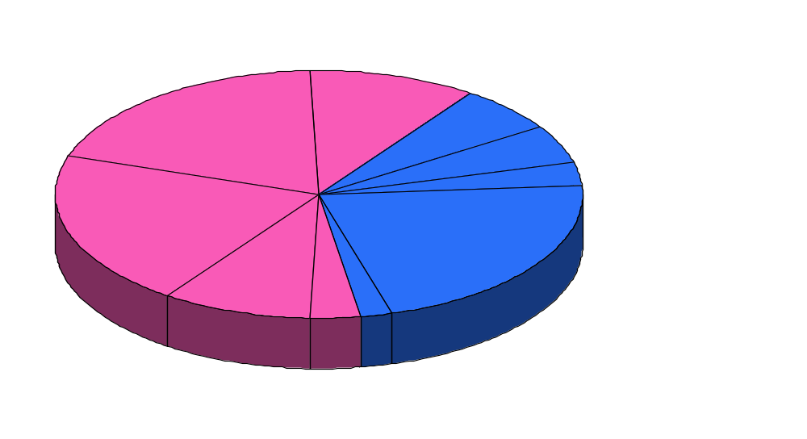
The Media Pie
(in Percentages of Total Transactions)
Periodicals (.10)
Letters (.20)
Unscheduled
Meetings (.06)
Scheduled Meetings (.05)
Tours (.03)
Memos (.19)
Telephone
Calls (.21)
Noncomputer Reports (.09)
Computer Reports (.03)
Business Meals (.02)
Written
Note:
Percentages do not add to 1.00 due to rounding
Oral
16-<number>

Slide 23
Ranking of Media by Value
Medium Mode Average Value
Scheduled meetings Oral 7.4
Unscheduled meetings Oral 6.2
Tours Oral 5.3
Social activity Oral 5.0
Memos Written 4.8
Computer reports Written 4.7
Noncomputer reports Written 4.7
Letters Written 4.2
Telephone calls Oral 3.7
Business meals Oral 3.6
Periodicals Written 3.1
16-<number>
Notes:
23

Slide 24
Information Use by Decisional Role
Disturbance
handler
(.42)
Entrepreneur
(.32)
Resource
allocator
(.17)
Unknown
(.06)
Negotiator
(.03)
16-<number>
Notes:
25

Slide 25
Jones & McLeod Study Findings
Most executives’ information came from environmental sources, but the internal information was valued higher
Most of the executives’ information came in written form, but the oral information was valued higher
Executives receive very little information directly from a computer
16-<number>
Notes:
26

Slide 26
Sources of Decisional Information
Disturbance
handler
.42
Environment
.43
Lower
levels
.38
Entrepreneur
.32
Internal
support units &
individuals .13
Resource
allocator
.17
Upper
levels
.05
Negotiator
.03
Committees
.02
Unknown
.06
16-<number>
Notes:
27

Slide 27
Unique Information Needs
Study conducted by John Rockart and Michael Treacy, both of MIT
Studied 16 companies in early 1980s
Found many computer users
Found some executives interested in detail
Coined the term “executive information system”
16-<number>
Notes:
28

Slide 28
EIS Features
A central purpose
A common core of data
Two principal methods of use
  Retrieve reports
  Conduct analyses
A support organization
  EIS coach
  EIS chauffeur
From Rockart and Treacy
16-<number>
Notes:
29

Slide 29
Putting Computer Use in Perspective
Two key points:
  1. Computer use is personal
  2. Computer produces only a portion of the
  executive's information
16-<number>
Notes:
32

Slide 30
Suggestions to Improve EISs
1. Take an inventory
2. Stimulate high-value sources
3. Take advantage of opportunities
4. Tailor the system to the executive
5. Take advantage of technology
16-<number>
Notes:
33

Slide 31
An EIS Model
Information
requests
Executive
database
Personal
computer
Information
displays
Executive workstation
To other
executive
workstation
To other
executive
workstation
Corporate
database
Make
corporate
information
available
Electronic
mailboxes
Current news,
explanations
Software
library
Corporate mainframe
External
data and
information
16-<number>
Notes:
34

Slide 32


An EIS Model
Executive workstation
Information
requests
Executive
database
Information
displays
To other
executive
workstation
To other
executive
workstation
Corporate
database
Make
corporate
information
available
Current news,
explanations
Electronic
mailboxes
Software
library
Corporate mainframe
External
data and
information
16-<number>
Notes:
34

Slide 33
Dialogue Between
Executive and EIS
Typically by a series of menus, keyboarding is minimized
Drill down to specific information needed from the overview level
16-<number>

Slide 34
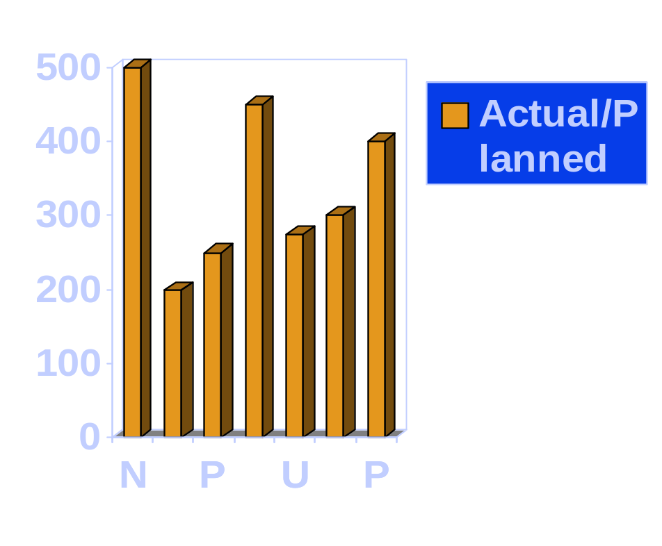
An Information Display That Includes a Computer-Generated Narrative Explanation
MEDIAL INTERNATIONAL GROUP MIG
Product Profitability Analysis
Magazines in Europe have been performing poorly. While sales are up, production costs have soared. This is due to the labor disputes in the pulp and paper industry. Starting next month, costs should be back in line with earlier projections.
x
1
0
0
Actual Planned Variance %Variance
Newspapers 1,421,709 1,559,184 (137,475) (8.82)
Magazines 490,855 518,687 (27,832) (5.37)
Periodicals 1,912,564 2,077,872 (165,308) (7.96)
16-<number>

Slide 35
Incorporation of
Management Concepts
Critical success factors
Management by exception
Mental model
  Information compression
16-<number>
Notes:
37

Slide 36
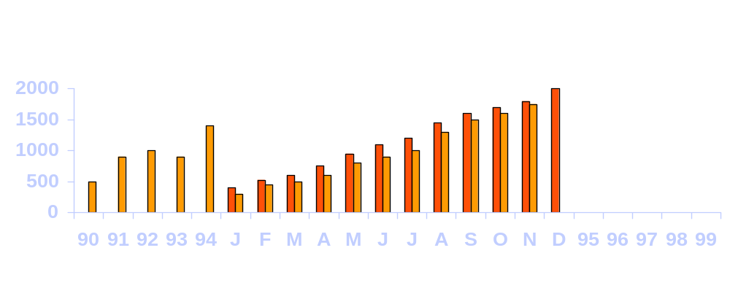
SALES
SALES - $ IN MILLIONS
AS OF NOVEMBER 1994
SOURCE
GLORIA YANDERS
BILL BLASS
HISTORY
BUDGET
CURRENT
ACTUAL
FORECAST
YEAR TO DATE
OVER/ UNDER MB
YEAR-END FORECAST CURRENT FORECAST
PROGRAM ACTUAL THIS MO LAST MO
HERC $861.4 $30.7 $59.1
C-5B 621.9 0.3 4.5
OTHER 398.7 12.9 10.1
TOTAL $1,882.0 $43.9 $44.4
Y-L O/U MB YR CURRENT O/ U PRIOR
$949.8 $28.6 95 $2102.6 $ 8.0
699.0 1.2 96 2400.0 105.0
458.8 13.6 97 3130.0 98.0
$2107.6 $43.4 98 3390.0 58.0
99 2110.0 281.0
COMMENTS FAVORABLE VARIANCE PRIMARILY DUE TO TWO ADDITIONAL HERCULES
SALES
16-<number>
Notes:
38

Slide 37
EIS Implementation Decisions
Three Key Questions:
1. Do we need an EIS?
2. Is there application-development software available?
3. Should we purchase prewritten EIS
software?
16-<number>
Notes:
39

Slide 38
Advantages of Prewritten Software
1. Fast
2. Doesn't strain information services
3. Tailored to executives
16-<number>
Notes:
40

Slide 39
EIS Critical Success Factors Rockart and DeLong
1. Committed/informed executive sponsor
2. Operating sponsor
3. Appropriate information services staff
4. Appropriate information technology (IT)
5. Data management
6. Link to business objectives
7. Manage organizational resistance
8. Manage the spread and evolution
16-<number>
Notes:
41

Slide 40
Prerequisite Activities for the EIS
Information
needs
Information
technology standards
Analysis of
Organization
Corporate
data model
Information
Systems Plan
Purchasing and
Performance
Systems
EIS
16-<number>

Slide 41
Future EIS Trends
Use will become commonplace
Decreasing software prices
Will influence MIS/DSS
The computer will always play a support role
16-<number>
Notes:
43

Slide 42
Summary
Executives have unique information needs
  Need for EIS
  Specific uses of EIS
EIS development
  Personal productivity software
  Prewritten
  Custom
EIS success factors
16-<number>

Slide 43
Chapter 15
MANAGEMENT INFORMATION SYSTEMS 8/E
Raymond McLeod, Jr. and George Schell
Enterprise Information Systems
15-<number>
Copyright 2001 Prentice-Hall, Inc.
Notes:
1

Slide 44
What is an Enterprise Information System (EntIS)?
Computer-based system that can perform all standard accounting tasks for all of the organizational units in an integrated and coordinated fashion
System purpose is to collect and disseminate data to all processes of the organization
Also called enterprise resource planning (ERP)
15-<number>
Notes:
2

Slide 45
Planning and Control
EIS Sitting Atop Business Area ISs
Aggregation
of Data
EIS
Marketing Information
Systems
Financial Information Systems
Human Resource Information Systems
Manufacturing Information Systems
Information Resources Information Systems
EntIS
Transaction Recording
Data Details
15-<number>

Slide 46
Evolution of EntIS
First ISs in 1960’s were TPSs
MISs
Manufacturing requirements planning (MRP)
  Developed to deal with complex issues of inventory control
MRP II
  Information systems that encompass the flow of material from vendors, through manufacturing, and to the firm’s customers
15-<number>
Notes:
5

Slide 47
Evolution of EntIS (cont.)
ERPs were next logical step
  All information about organizational processes is consolidated
  Requires large commitment of hardware resources, sophisticated software, database management systems, and well-trained users
15-<number>
Notes:
5

Slide 48
Driving Forces
Behind ERP Popularity
Fears about Y2K problems
Difficulty in achieving enterprisewide systems
Recent flurry of corporate mergers
Follow-the-leader competitive strategies
15-<number>

Slide 49
ERP Software Industry
Only limited number of vendors
Five largest vendors had combined sales of $10 billion in 1998
Largest vendor is SAP (www.sap.com)
Training and consulting are also big expenditures in this area
15-<number>
Notes:
6

Slide 50
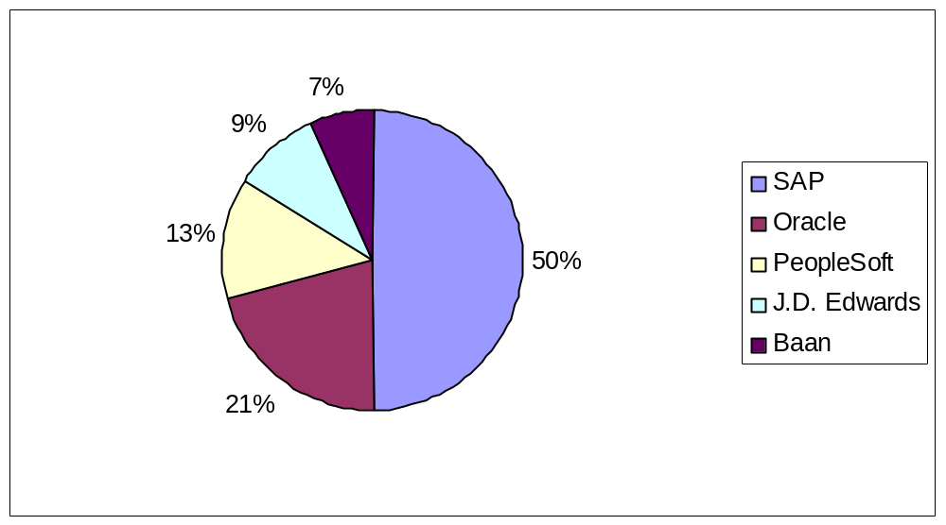
1998 ERP Sales of Top Five Vendors
15-<number>

Slide 51
Back Office Systems
Another name for ERP
Traditionally ERP focused on internal entities
EntIS is evolving outside the firm
15-<number>
Notes:
7

Slide 52
EntIS Feasibility
ERP is a large investment and must be treated as such
Investment entails more than cash outlays
  Commitment to focus on interacting business processes
Benefits are not always economic
Many feasibility issues need consideration
15-<number>
Notes:
9

Slide 53
Economic Feasibility
Concerned with justifying an expenditure by considering both costs and benefits in monetary terms
Investment costs for ERP
  Very high: $10 million for a moderate sized application
  High likelihood of negative ROI
Tangible and intangible benefits must be considered
Opportunity costs of NOT implementing ERP
15-<number>
Notes:
10

Slide 54
Technical Feasibility
EntIS must be viewed as technically complex systems resting organizational database management systems
EntIS may reside on single computer or be distributed
  May strain computing resources
  May strain communications resources
Usually requires latest technology particularly in larger organizations
15-<number>
Notes:
11

Slide 55
Operational Feasibility
Persons in the organization must be willing and able to achieve the change from current IS to an EntIS
Is business process standardization desirable?
  Loss of personalization of customer data
  Cultural changes
Need for EntIS Champion
15-<number>
Notes:
12

Slide 56
EntIS Champion
Person or group who serves as driving force behind the organization’s change to EntIS
Variety of people can be EntIS champion
Lead the organization to a fundamental revamping of core business processes
15-<number>
Notes:
13

Slide 57
Possible EntIS Champions
1. Chief executive officer
2. Teams of senior management
a) Chief information officer
b) Vice president of manufacturing
c) Chief financial officer
d) Other senior managers
3. Collection of well-respected middle managers from a wide spectrum of organization operations
15-<number>
Notes:
15

Slide 58
EntIS Implementation
Particular attention must be paid to software vendors, training, and cutover
Takes months
  Average is about two years
  Due to complexity and legacy systems developed years earlier
Variety of approaches can be taken
15-<number>
Notes:
18

Slide 59
EntIS Vendor Selection
Choice of vendor is important
Underlying business concepts in vendor’s system should be major criteria
After major ERP pieces are in place, firm may want to consider bolt-on systems
  Software that takes advantage of ERP features
    Customer relations management
    Demand forecasting
    Logistics
15-<number>
Notes:
20

Slide 60
User Training
Cannot be an afterthought
Must be part of the initial design
Requires users to understand business processes beyond their normal jobs
ERP vendors provide training services
SAP is a leader in Training
15-<number>
Notes:
21

Slide 61
Training Related to
ERP Software
Type of Training
Learning ERP Vendor Software
Training by ERP Vendor (or company specializing in ERP training)
Peer-to-peer training such as conferences
When Training Should Occur
Before the EntIS is planned and designed
As the is being designed and implemented; also after the system is implemented
Especially helpful after the implementation of EntIS projects
15-<number>
Notes:
15

Slide 62
SAPPHIRE
SAP’s user support group
Composed of SAP employees, customers, vendors of products that work with SAP
Purpose is NOT to sell SAP
  Learn its features
  Make better use of its capabilities
15-<number>

Slide 63
ERPWorld Organization (www.erpworld.com)
ERPWORLD.COM is an International Industry Analyst group
focusing on eBusiness and Enterprise application projects
Not affiliated with any particular vendor
Promotes knowledge and understanding of ERP
15-<number>

Slide 64
EntIS Implementation
Cutover Approaches
Immediate
  Extremely dangerous
  Failure could stop all organizational information processing
Phased
  Segments related to various business processes are implemented in sequence of importance
  Most viable method
15-<number>
Notes:
26

Slide 65
EntIS Implementation
Cutover Approaches (cont.)
Parallel, often proceeded with a pilot effort
  EntIS and original system operate together for a period of time until EntIS is proven to work
  Often too costly
  May require more computing resources than a firm can acquire
15-<number>
Notes:
26

Slide 66
Minimizing EntIS Failures
1. Understand the organization’s span of complexity
2. Recognize processes where value cannot be maintained if standardization is imposed
3. Achieve a consensus in the organization before deciding to implement an enterprise information system
15-<number>
Notes:
28

Slide 67
EntIS and the Web
Ease of use
  Web browsers are a viable interface for EntIS
  Users don’t have to learn a new interface
  WWW can provide a portal for an ERP vendor’s applications
  Organization can be given location in an electronic mall provided by vendor
  Benefits entities outside the boundaries of the organization
15-<number>
Notes:
29

Slide 68
EntIS and the Web (cont.)
Customer concerns
  EntIS are large and complex
  Challenge to EntIS firms is to standardize sales processes
  Organizations may choose to only allow business-to-business transactions to interface with their EntIS
15-<number>
Notes:
29

Slide 69
Future of EntIS
EntIS industry is currently growing at a rate exceeding 30% per year
Two directions
  Rapid development
  Enterprise resource management
User-friendly software
Converging database and Enterprise systems
15-<number>

Slide 70
Accelerated ERP
Development Tools
Two-year implementation efforts are just too long
Accelerated ERP model
  Simplification of the enterprise resource planning steps
  SAP’s is called ASAP
First order of business is to become a competent user of ERP vendor’s software
15-<number>

Slide 71
Summary
EntIS
  Integrates all organizational units
ERP enables the management of an organization’s resources
  Deals with internal processes
EntIS history
  Part of IS evolution beginning in 1960’s
  Currently growing at exceptional rate
15-<number>

Slide 72
Summary [cont.]
EntIS considerations
  Cost
  Training
  Success versus failure
EntIS future
  Move beyond firm’s boundaries
  Focus on the Web environment
15-<number>

Slide 73
Chapter 18
MANAGEMENT INFORMATION SYSTEMS 8/E
Raymond McLeod, Jr. and George Schell
Information Resources
Information Systems
18-<number>
Copyright 2001 Prentice-Hall, Inc.
Notes:
1

Slide 74
Information Resources Include:
Specialists
  Systems analysts, programmers, database administrators, network specialists, operations personnel, and others
Hardware
Software
Users
Data
Information
Represents a large
organizational
investment!
18-<number>

Slide 75
Information Specialists
Most located in the information services unit
There is a trend to locate specialists throughout the firm
Actual organization chart depends on the needs of the firm
18-<number>

Slide 76
A Functional Organization Structure
for Information Services
CIO
Manager
of systems
development
Manager
of systems
maintenance
Manager
of computer
operations
Manager
of systems
administration
Network
manager
Systems
analyst
Systems
analyst
Operations
personnel
Database
administrators
Network
specialists
Programmers
Programmers
18-<number>

Slide 77
Information Resources
Most are located in information services
Most that are centrally located are CIO’s responsibility
Those located in functional areas are the responsibility of the area manager
18-<number>

Slide 78
Model of an IRIS
Input subsystems
  AIS
  Information resources research
  Information resources intelligence
Output subsystems
  Hardware
  Software
  Human resources
  Data and Information
  Integrated resource
18-<number>

Slide 79
A Model of an Information Resources
Information System
Hardware
subsystem
Accounting
information
system
Software
subsystem
Internal sources
Information
resources
research
subsystem
Human resources
subsystem
Database
Users
Environmental sources
Data and
information
subsystem
Information
resources
intelligence
subsystem
Integrated
resource
subsystem
18-<number>

Slide 80
Information Resources
Research Subsystem
Describes functions involved in special research projects within the firm
Performed by systems analysts interacting with users
18-<number>

Slide 81
Information Resources Intelligence Subsystem
Describes functions involved in gathering information from elements in the firm’s environment
  Government
  Suppliers
  Labor unions
  Global community
  Customers
  Competitors
18-<number>

Slide 82
CIO Responsibilities
Can be top-level executive who participates on executive and MIS steering committee
Contributes to strategic planning for firm and IS functions
Primary source of leadership for:
  Achieving and maintaining information quality
  Keeping information resources secure
  Planning for contingencies
  Keeping information costs under control
18-<number>

Slide 83
Achieving Quality Products and Services
1) Identify IS customers
  MIS steering committee
  Use of a formal system works best
2) Define customer quality needs
  Product quality needs
  Service quality needs
18-<number>
Notes:
9

Slide 84
IS Takes Six Basic Steps in
Achieving Quality Management
1
Identify IS customers
2
Define customer quality needs
3
Establish quality metrics
4
Define quality strategy
5
Implement IS quality programs
6
Monitor IS quality performance
18-<number>

Slide 85
Comparison of How IS and Middle-Level
Manager-Users Perceive Product Quality
Perceived Value
Dimension IS User Aggregate
Accurate 4.91 4.88 4.89
Trusts output 4.90 4.86 4.87
Works as specified 4.75 4.73 4.73
User friendly 4.50 4.75 4.68
Relevant 4.59 4.53 4.53
Fast response time 4.12 4.55 4.42
Meets all user needs 4.22 4.48 4.41
No downtime 3.96 4.25 4.16
Delivered on time 3.80 4.16 4.05
Has user documentation 4.21 3.93 4.01
Can be changed quickly 3.84 4.04 3.98
Delivered on budget 3.45 3.67 3.61
Low cost of operation 3.19 3.49 3.40
Has programmer documentation 3.74 3.23 3.39
Uses new technology 3.04 3.28 3.21
18-<number>

Slide 86
Achieving Quality Products and Services [cont.]
3) Establish quality metrics
  Information product quality
  Information service quality
4) Define the IS quality strategy
  Recruiting and training
  User-oriented systems development
    Market analysis
    Product acceptance analysis
    Task analysis
    Prototype tests
    Operational Systems tests
18-<number>

Slide 87
Basic Competencies Expected
of IS Job Applicants
1. Concern for effectiveness
2. Initiative
3. Enthusiasm for work
4. Self-confidence
5. Concern with impact
6. Interpersonal astuteness
7. Conceptual thinking
8. Analytical thinking
9. Effective communication
10. Flexibility
See Table 18.2
18-<number>

Slide 88
Special Attention to Human Factors
Ensures That Users’ Needs are Incorporated
into Systems Designs
Conduct a
market analysis
1.
Planning
phase
5.
Use phase
2.
Analysis phase
Conduct a product
acceptance analysis
4.
Implementation
phase
Conduct
operational
system tests
3.
Design
phase
Conduct a
task analysis
Conduct
prototype tests
18-<number>

Slide 89
Achieving Quality Products and Services [cont.]
5) Implement IS quality programs
  Implementation varies with firm
6) Monitor IS quality
  Performance of IS specialists and the unit
18-<number>

Slide 90
Security Objectives
Confidentiality
Availability
Integrity
Current attention is focused on malicious software such as computer viruses.
18-<number>
Notes:
16

Slide 91










Unauthorized Acts Threaten System Security Objectives
Unauthorized
use
Information
Unauthorized
disclosure
and theft
Confidentiality
Availability
Integrity
Unauthorized
destruction and
denial of service
Security
Unauthorized
modification
18-<number>
Notes:
17

Slide 92
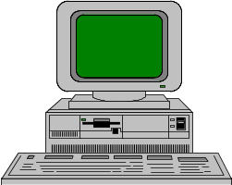
Users
Identification
User
Profiles
Authentication
Authorization
Access
control
files
Audit
log
Software
library
Report
writer
Database
Access Control Functions
Security
reports
18-<number>
Notes:
19

Slide 93
Access Control
Identification
  What you know (password) or
  Where you are (terminal location)
Authentication
  What you have (badge)
Authorization
  Level of use
High-grade threats are
from sophisticated
computer criminals
18-<number>
Notes:
20

Slide 94
Contingency Planning
Emergency plan
Backup plan
  Redundancy
  Diversity
  Mobility
    Reciprocal agreement
    Hot site
    Cold site
    Empty shell
18-<number>
Notes:
21

Slide 95
Vital Records Plan
Electronic vaulting
  Day end backup of files electronically
Remote journaling
  Transmission of transaction data as the transactions occur
  Used to update remote database in batch form later
Database shadowing
  Involves updating of duplicate database at remote site as transaction occur
18-<number>
Notes:
22

Slide 96
Cost-Reduction Strategies
Consolidation
  Reduces number of separate locations for information resources
  Easiest to achieve in terms of information resources
  More difficult by end-user computing needs
18-<number>
Notes:
23

Slide 97
Cost-Reduction Strategies [cont.]
Downsizing
  Migrating to smaller platforms
  Advantage of cost reduction
  Advantage of increased productivity with PCs located in user areas
  Risk of lost security
18-<number>
Notes:
24

Slide 98
Cost-Reduction Strategies [cont.]
Outsourcing
  Data entry and simple processing (editing, formatting)
  Contract programming
  Facilities management (FM)
  Systems integration (SI)
  Support for maintenance, service, or disaster recovery
18-<number>
Notes:
24

Slide 99
Objectives of Outsourcing
Manage costs better
Reduce
Contain
Predict
Obtain relief from systems maintenance so as to concentrate on new system development
Acquire needed expertise
18-<number>
Notes:
26

Slide 100
Information Management in Three Pacific Rim Countries
Countries were U.S., Korea, and Mexico
Centralization versus decentralization
  Most firms were centralized
CIO participation in strategic business planning
  CIO has a long way to go before achieving status as a top-level executive
18-<number>

Slide 101
Information Management in Three Pacific
Rim Countries [cont.]
Information systems planning
  Most firms have IS plan
  CIO is primarily responsible
Sharing information resources with users
  In general, CIOs support end-user computing trends
18-<number>

Slide 102
Proactive CIO Strategy
1) CIO must emphasize quality management of the IS resource
2) Achieve strong user ties
3) Strengthen executive ties
4) Assemble an IS management team
5) Assemble staff competent in leading-edge technologies and methodologies
6) Build an IRIS
18-<number>

Slide 103
The Future of the CIO
Business computing is moving from centralized to decentralized computing in terms of:
  Equipment
  Development
  Decision making
CIO Roles
  Big brother
  Helping hand
  Watchdog
  Networker
18-<number>

Slide 104
Donovan’s Four Stages of Decentralized Computing
Centralized
D Network
Decentralized
Watchdog
C
Decentralized
B Helping hand
Development
Decision making
Big brother
A
Centralized
Decentralized
Equipment
18-<number>
Notes:
31

Slide 105
Summary
Information resources located in IS are the responsibility of the CIO
IRIS is used to manage information resources within an organization
CIO must:
  Promote quality information products and services
  Ensure security of IS
  Prepare for disasters
18-<number>

Slide 106
Summary [cont.]
IS cost cutting considerations
  Consolidation
  Downsizing
  Outsourcing
CIO can be proactive
18-<number>

